Slide 1
Keyboard and Display
Lecture 14

Slide 2
keyboard, data, memory addresses, and machine code can be entered in the hexa­decimal form.
In addition to the numeric keys, a keyboard may include functional keys to enter monitor and control commands.
For output, memory addresses and data can be displayed on light-emitting diode (LED) display devices.
Keyboard Design
Unlike a terminal, a mechanical contact keyboard, for which the key switches are organized in a matrix form, does not include any electronics.
Figure 9-30 illustrates how a 64-key keyboard can be interfaced to a microcomputer through two parallel I/O ports

Slide 3
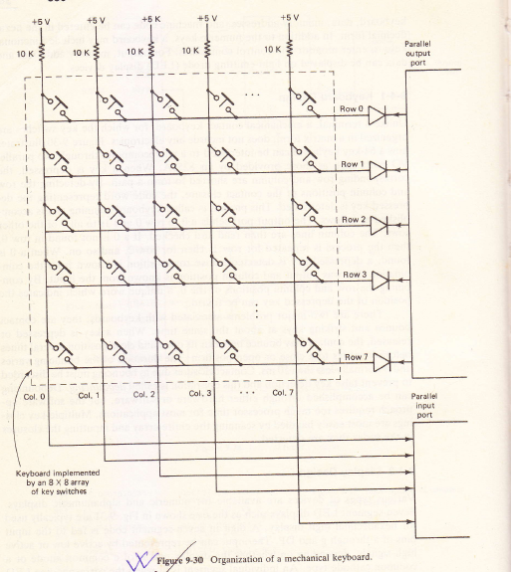

Slide 4
When a key is depressed, the corresponding row and column are shorted to form a path.
By detecting the row and column positions of the contact closure, the code word representing the depressed key is determined.
This process is called keyboard scanning and is accomplished as follows.
The output port sends a 0 to row 0 and 1s to all 7 of the other rows.
The column lines are then read and checked. If a 0 is not found in row 0, then the process is repeated for row 1, then for row 2, and so on.

Slide 5
When a 0 is found, a depressed key is detected whose row position is known from the combination that was output and column position is known from the input.
By combining the row and column positions of the 0, a unique word which indicates the position of the depressed key can be found.
There are two major problems associated with keyboards; they are contact bounce and striking keys at about the same time.
When a key is depressed or released, the contact may bounce between its open and close position several times before it settles to a close or open position.
The duration of the bouncing varies and is normally less than 10 ms. Contact closures due to bouncing must be discarded to prevent false key detection and this operation is called debouncing.

Slide 6
Debouncing can be accomplished through either hardware or software, but the software approach requires too much processor time for most applications.
Multiple key closings are most easily handled by scanning the entire array and inputting the closures in the order they are detected.
Display Design
Various types of devices are available for numeric and alphanumeric displays.
Seven-segment LED displays such as the one shown in Fig. 9-31 are typically used for hexadecimal digit display.
A digit in seven-segment code is fed to the input pins of a through g and DP. The input can be represented by active low or active high signals, depending on whether the display unit is of a common anode or a common cathode type. An individual segment is lit when the corresponding LED is forward biased.

Slide 7
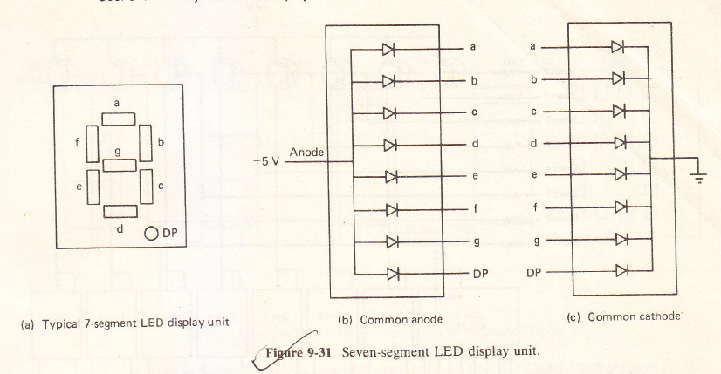

Slide 8
Keyboard/Display Controller
Although interfacing a keyboard and multiple-digit display to parallel I/0 ports is simple from a hardware standpoint, while inputting and outputting the processor would be tied up by keyboard scanning and display refreshing routines.
The Intel 8279 keyboard/display controller is an LSI device designed to release the processor from performing the time-consuming scan and refresh operations.

Slide 9
Figure 9-34 shows the general structure of the 8279 and its interface to the bus.
The control and status registers share the odd address and the data buffer register uses the even address.
The addressing is according to the following table:
where 1 means high and 0 means low.
CS | RD | WR | A0 | Transfer Description
0 | 1 | 0 | 0 | Data bus to data buffer register
0 | 1 | 0 | 1 | Data bus to control register
0 | 0 | 1 | 0 | Data buffer register to data bus
0 | 0 | 1 | 1 | Status register to data bus

Slide 10
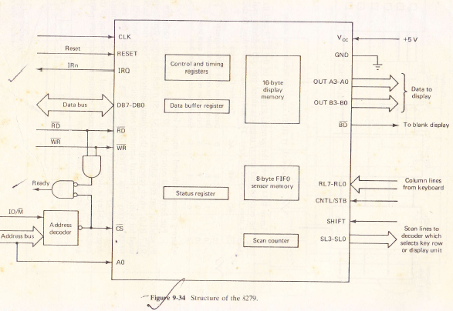

Slide 11
For keyboard control, the 8279 constantly scans each row the keyboard by sending out row addresses on SL2-SL0 and inputting signals on the return lines RL7-RL0, which represent the column addresses.
Note that the SL3-SL0 Lines are used for both keyboard scanning and display refreshing and will accommodate up to 16 display unit.
When a depressed key is detected, the key is automatically debounced by waiting 10 ms to check if the same key remains depressed.
If a depressed key is detected an 8-bit code word corresponding to the key position is assembled by combining the encoded column position, row position, shift status, and control status as shown below.

Slide 12
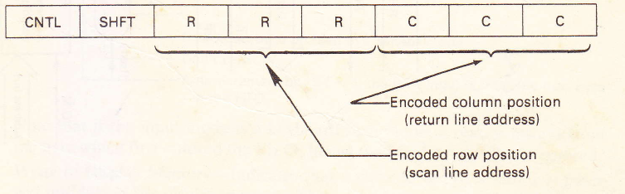
The SHFT and CNTL pins are used primarily to support typewriter-like keyboards which have shift and control keys.
The key position is then entered into the 8 x 8 first-in/first-out (FIFO) sensor memory, and the IRQ (interrupt request) line is activated if the sensor memory was previously empty.
The control and timing registers are physically a collection of flags and reg­isters that are accessed by commands which are sent to the 8279's odd address.
The three MSBs of a command determine its type and the meaning of the remaining 5 bits depends on the type. Although there are eight types, only three of them are considered here. The formats of the three commands of interest to us are:

Slide 13
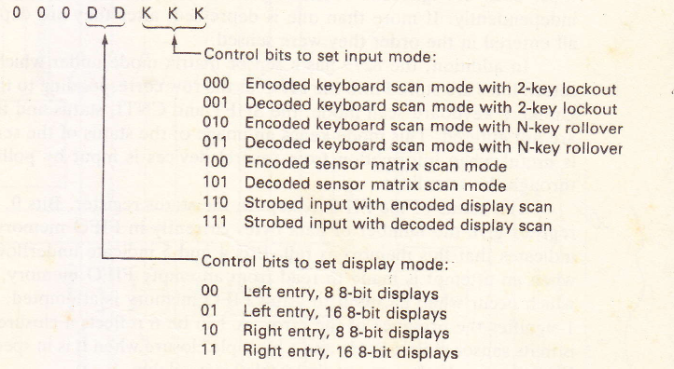
Keyboard Display Mode Set-Specifies the input and display modes and is used to initialize the 8279. Its format is:

Slide 14
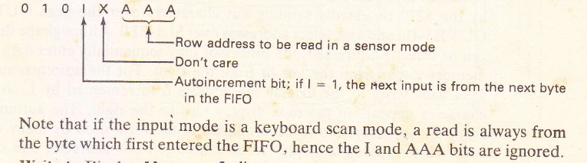
Read FIFO Sensor Memory-Specifies that a read from the data buffer register will input a byte from the FIFO memory and, if the 8279 is in the sensor mode, it indicates which row is to be read. This command is required before inputting data from the FIFO memory. Its format is:

Slide 15
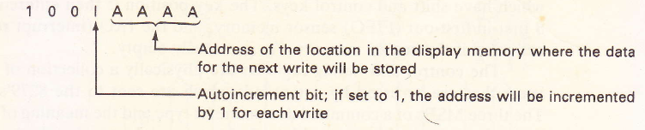
Write to Display Memory-Indicates that a write to the data buffer register will put data in the display memory. This command must be given before the CPU can send the characters to be displayed to the 8279. Its format is:

Slide 16
The 8279 provides two options for handling the situation in which more than one key is depressed at about the same time.
With the two-key lockout option, if, another key is depressed while the first key is being debounced, the key which is released last will be entered into the FIFO.
If the second key is depressed within two scan cycles after the first is debounced and the first key remains depressed after the second one is released, then the first depressed key is recognized.
Other­wise, both are ignored. The N-key rollover option treats each key depression independently. If more than one is depressed, after they are depressed they are all entered in the order they were sensed.

Slide 17
The status of the FIFO is kept in the status register. Bits 0, 1, and 2 of this register give the number of data bytes currently in FIFO memory and bit 3 = 1 indicates that this memory is full.
Bits 4 and 5 indicate underflows, which occur when an attempt is made to read from an empty FIFO memory, and overflows, which occur when an input to a full FIFO memory is attempted.
In both cases a 1 signifies the presence of the error.
A 1 in bit 6 reflects a closure when the 8279 is in its sensor matrix mode and a multiple closure when it is in special error mode.
Bit 7 shows whether or not the display is available.

Slide 18
For display control, the 8279 provides a 16-byte display memory and refresh logic. Each address in the display memory corresponds to a display unit, with address 0 representing the leftmost display unit.
Once the CPU loads the characters to be displayed into this memory, the 8279 needs no further instructions and the processor is released from refreshing the units.
The output is accomplished by the 8279 repeatedly sending out characters over the lines OUT A3-A0 and OUT B3-B0 and unit select addresses over SL3-SL0.

Slide 19
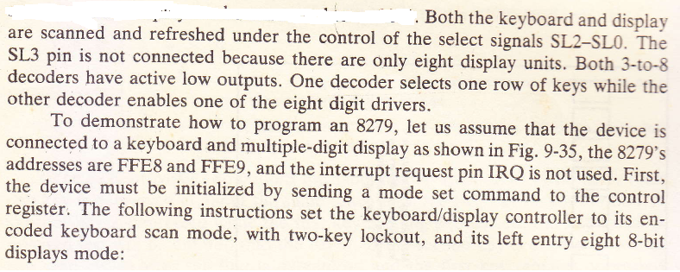
Figure 9-35 illustrates one way in which a 64-key keyboard and an eight-digit seven segment display can be connected to an 8279

Slide 20
